Slide 1
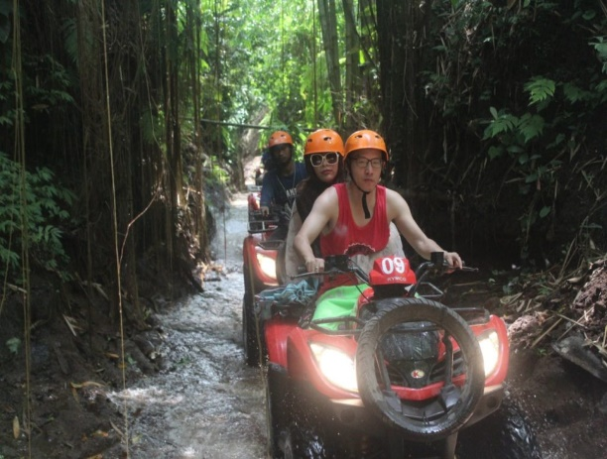
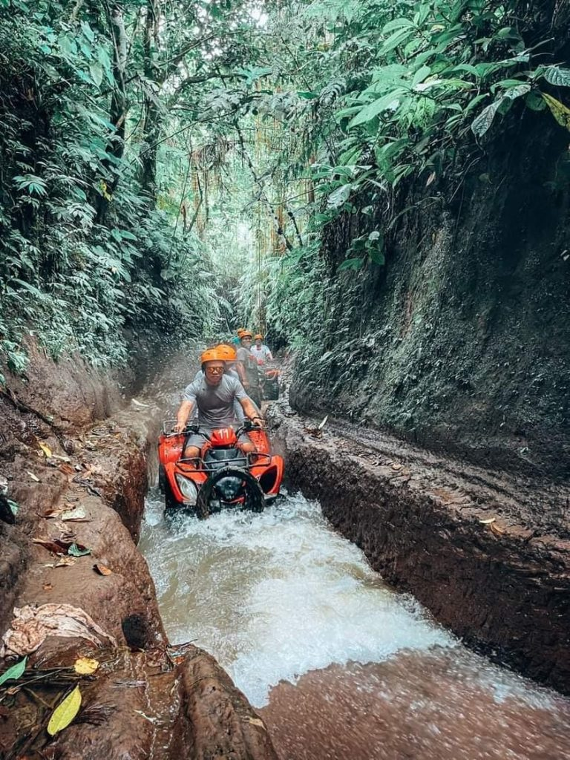

ATV Adventure
While you in Bali absolutely Ubud could be in your list, and we located just 15 minutes from Ubud. We offer a challenge for adventurer for the ATV ride. As our standard to maintain the service and tour running safely, fun, and memorable, our professional instructor will give you Briefing about how to ride ATV, Use safety equipment, Standard of safety and trek information.
This tour has two optional 5 km and 7 km length of the trek with duration 1 hours and 2 hours through some interesting such as stunning scenery, uphill and downhill jungle trek, muddy trek, rice paddies, river trek, fun spiral trek, pond trek, as well tunnel and water splash. Along the way you will admire with natural view and fresh air.
Our guide will ensure that your adventure is safe, comfortable and fun. Let’s join us and had a great adventure with your family member, friend or your partner. Adventure is out there and get
INCLUDE
Welcome Drink
Locker and changing room
Experienced and Professional Guide
Safety equipment (helmet & boot shoes)
Hot shower facilities (soap & shampoo), Clean Towel
Buffet Lunch, Coffee & Tea
Insurance covered IDR 500.000.000
Air conditioned private return transfer

Slide 2

JUNGLE BUGGIES
Start your engines and get ready to embark on a journey into the jungle to experience Bali’s first and only purpose-built ATV track. This thrilling new course, spanning 5km over each lap, was crafted with the hardiest adventure seekers in mind to provide an exciting and intense driving experience like no other on the island.
TOUR INCLUSIONS
Full Safety Equipment
3 Laps on the Track
Access to the Mason Gourmet Chocolate Factory Showroom
Delicious Lunch
Air-Conditioned Hotel Transfers
Emergency Accident Insurance
Emergency Air Medivac*
Free Wi-F, NEED TO SHOW YOUR DRIVING LICENSE
Pick up : 07.30 – 08.00 AM

Slide 3
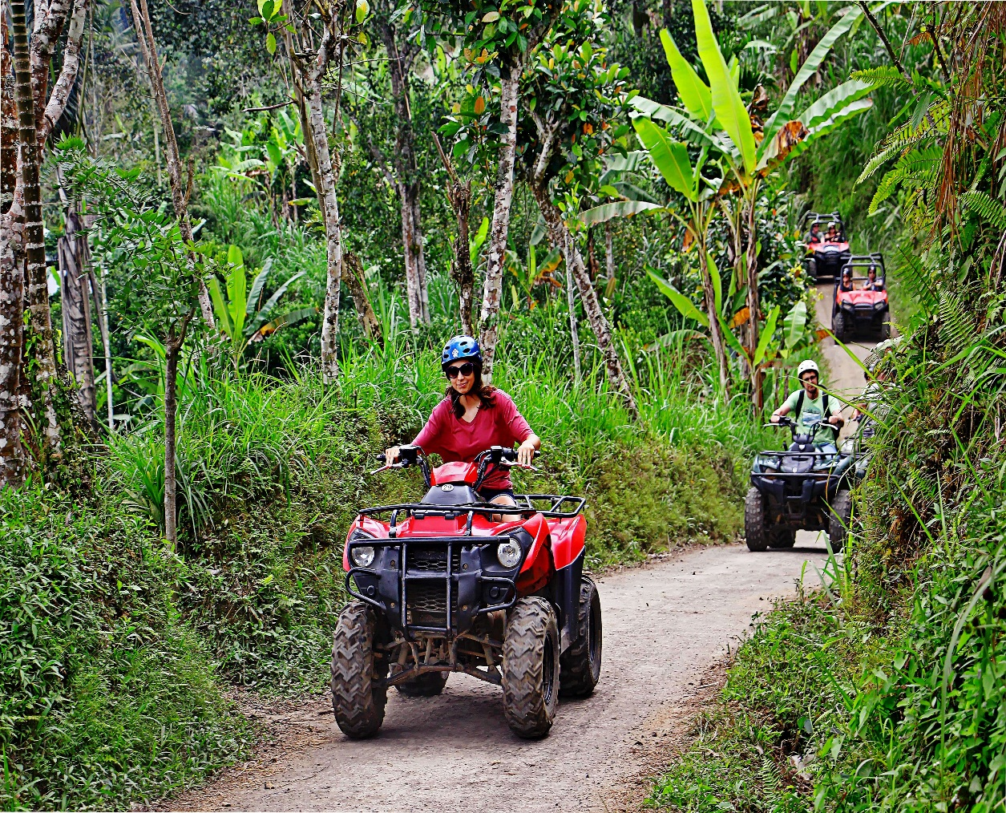
QUAD BIKE
Detail Itinerary
Get ready to get dusty & muddy as you drive yourself through 5 different types of authentic Balinese terrain! Enjoy the quad bike adventure through rice fields, plantations, crossing the jungle, mud tracks, and 2 traditional villages in Desa Kerta, Payangan! Quads are fully automatic & easy to operate, but if you prefer, you can ride as a passenger with somebody from your group or our one of our guides. All of our tours are accompanied by experienced guides. Also, groups will be split up in to different groups, based on driving skill, to make sure that each tour is catered to your liking.
Meal Description
Lunch
Days of Operation
Daily
Start Time
Early Bird Tour pick up 07.15 am
Morning Tour : pick up 09.15 am
Afternoon Tour : pick up 12.15 pm

Slide 4
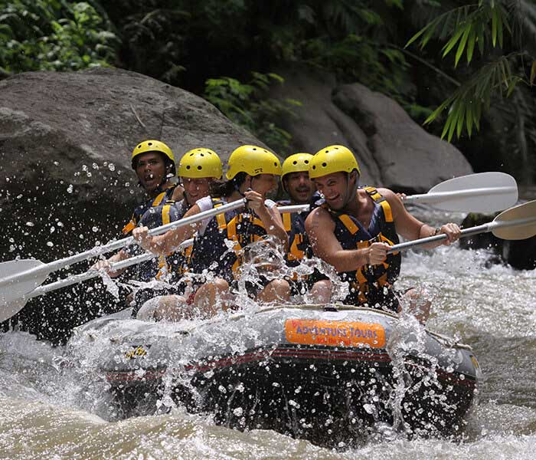
WHITE WATER RAFTING
Get wet and wild with the pioneers of Bali’s adventure industry, and enjoy a thrilling and scenic journey along the enigmatic Ayung River in Ubud. Featuring Bali’s longest white water rafting trip and exclusively providing the only premium experience available on the island from start to finish; including the best facilities, equipment, safety, food and service.
TOUR INCLUSIONS
Complete, Modern Safety Equipment
Gourmet Buffet Lunch
Change Rooms, Towels & Hot Showers
Electronic Security Lockers
Air-Conditioned Hotel Transfers
Emergency Accident Insurance
Emergency Air Medivac*
Free Wi-Fi
Pick Up 07.00 – 07.30 AM

Slide 5
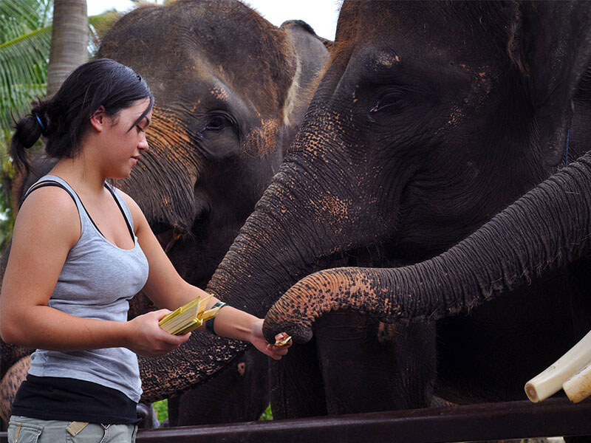
ELEPHANT PARK TOUR
Walk on the wild side with an informative and scenic stroll atop an elephant through our park and the cool Taro jungle. An experience you’ll never forget, interacting and exercising with our resident giants. Afterwards, enjoy lunch with a view of the elephant bathing lake in our Park Restaurant.
TOUR INCLUSIONS
All Park Facilities & Attractions
Full Buffet Lunch
Air-Conditioned Hotel Transfers
Accident Insurance
Emergency Air Medivac*
Free Wi-Fi
Pick Up : 07.30 – 08.00 AM

Slide 6
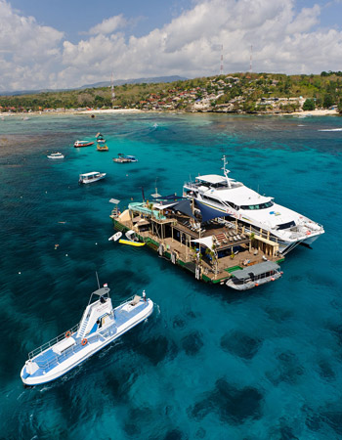
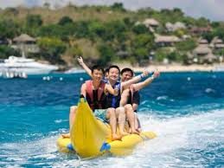

Lembongan Island Beach Club Cruise
Detail Itinerary
Let us whisk you away to Nusa Lembongan Island as you enjoy this beautiful region of Bali on our Lembongan Beach Club Cruise. During the Bali Hai Beach Club Cruise you will cruise to Nusa Lembongan aboard Bali Hai II, our luxury catamaran. Upon arrival in Lembongan Bay we will transfer you to Mushroom bay to experience the unspoiled charms of a peaceful tropical island at the private Bali Hai Beach Club
Relax on golden beaches, snorkel and swim from the beach in tropical water, or just relax in the hammocks of our peaceful gardens. If the mood takes you, an array of day activities add to the tropical atmosphere such as kayaking, snorkeling, scuba diving, parasailing plus lots more. The Beach Club experience can be combined with any of our other day activities, offering something for everyone in your family. At lunch time there is an appetizing BBQ lunch, which includes salads and fresh fish grilled at our pool-side cabana. Enjoy this wide selection of food with a range of cocktails at our exclusive Lembongan Beach Club Bar.
Journey Highlights
• Cruise to Nusa Lembongan with luxury catamaran.
• Spend the day at Bali Hai Private Beach Club.
• Activities such as kayaking, snorkeling, banana ride
Pick Up : 07.15 AM - 07.45 AM

Slide 7
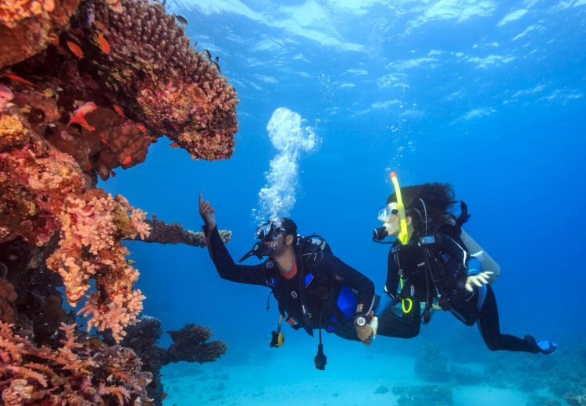
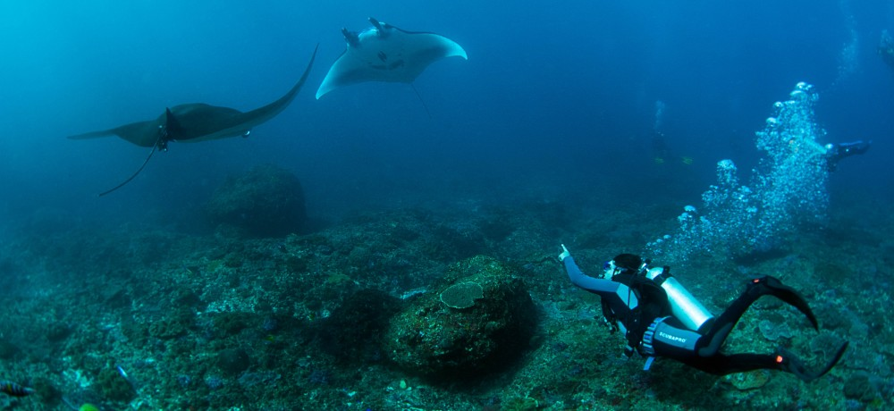
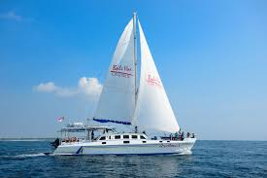
Beach Club Cruise & Scuba Dive at Lembongan
Detail Itinerary
The Discover Lembongan Scuba Day Trip is an all-inclusive scuba diving experience, consisting of one dive from our pontoon, perfect for beginners. Starting in mainland Bali, we'll pick you up at Benoa Harbor and ferry you to Nusa Lembongan, a small tropical island with crystal-clear waters and golden sand beaches. Upon arrival, we'll drop anchor alongside our purpose-built pontoon, which will serve as your jumping off point for all of your aquatic adventures.
First time divers will receive a thorough explanation before taking their first breaths underwater. During your session an experienced PADI professional will guide you through the entire experience and never leave your side. Once you've gotten the hang of it, you'll be transfixed by the stellar coral reefs and abundance of tropical marine life. It's truly an unforgettable experience.
When you're not diving, you can take advantage of other aquatic activities aboard the pontoon, including snorkeling, parasailing, kayaking, banana boat rides, semi-submersible coral viewing, and underwater viewing chamber, diving boards, and a 35m-waterslide.
Journey Highlights
• Cruise to Nusa Lembongan with luxury catamaran.
• Spend the day at Bali Hai Private Beach Club.
• Activities such as kayaking, snorkeling, banana ride and 1 x Dive
Pick Up : 07.15 AM - 07.45 AM,

Slide 8
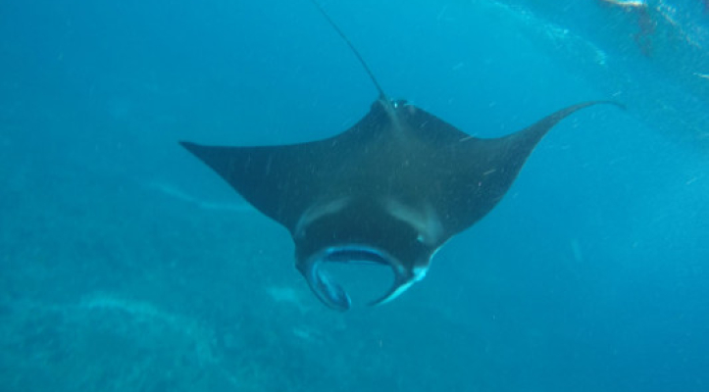
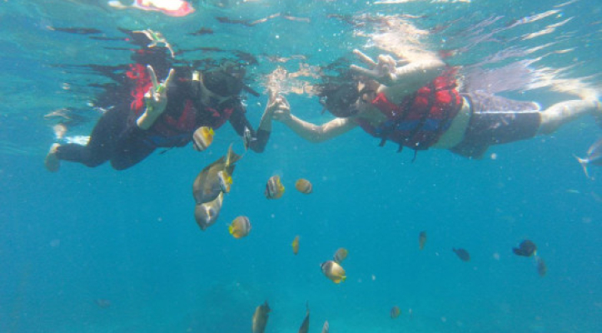
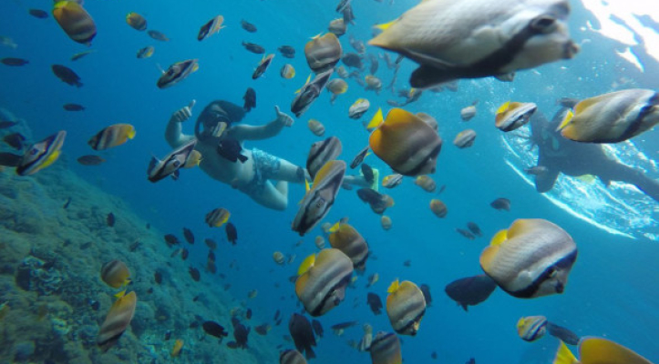
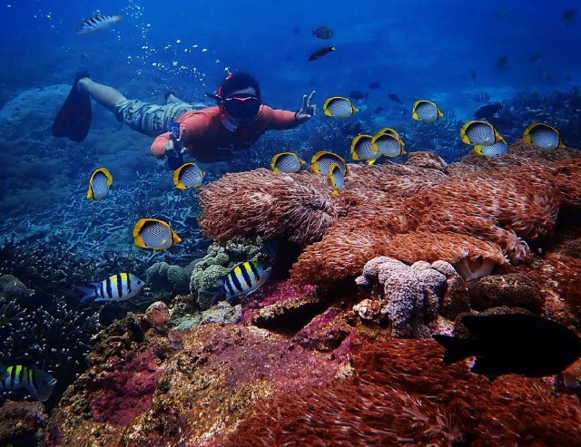
Snorkeling in Nusa Penida
Bali has become one of the favorite tourist destinations for both foreign and domestic tourists because it has both cultural and natural tourist attractions.
Talking about natural tourism, there is one island in Bali that presents various kinds of exotic natural attractions. The island is Nusa Penida which is located in the southeast of the island of Bali and has an area of ​​​​202.8 sq km and has a variety of natural attractions with various attractions presented.
In addition, on this island there are also various kinds of amazing snorkeling attractions with natural underwater views. Well, for those of you who like diving, you can try snorkeling attractions in several places on the island of Nusa Penida.
Tour Inclusion :
Snorkeling in 4 locations including: Gamat Bay, Crystal Bay,
Wall Point And Manta Bay
Lunch at Beach Club and free using swimming pool
Snorkeling Equipment
Pick up transport
Pick Up time : 06.30 -06.45 AM

Slide 9
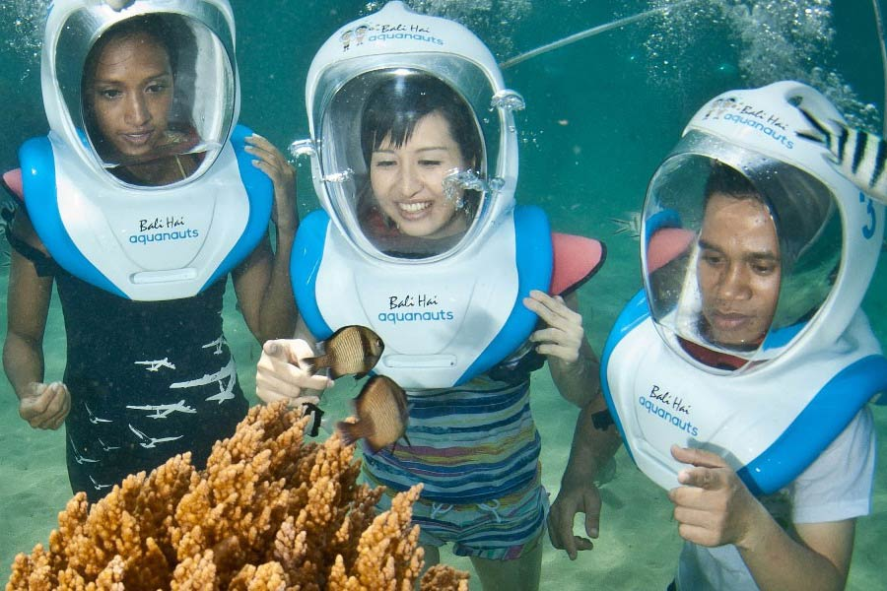
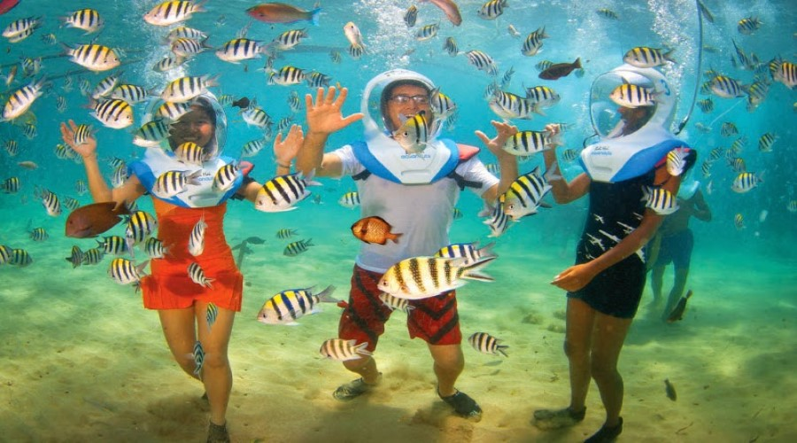
Beach Club Cruise & Aquanauts
Detail Itinerary
Let us whisk you away to Nusa Lembongan Island as you enjoy this beautiful region of Bali on our Lembongan Beach Club Cruise. During the Bali Hai Beach Club Cruise you will cruise to Nusa Lembongan aboard Bali Hai II, our luxury catamaran. Upon arrival in Lembongan Bay we will transfer you to Mushroom bay to experience the unspoiled charms of a peaceful tropical island at the private Bali Hai Beach Club
Relax on golden beaches, snorkel and swim from the beach in tropical water, or just relax in the hammocks of our peaceful gardens. If the mood takes you, an array of day activities add to the tropical atmosphere such as kayaking, snorkeling, scuba diving, parasailing plus lots more. The Beach Club experience can be combined with any of our other day activities, offering something for everyone in your family. At lunch time there is an appetizing BBQ lunch, which includes salads and fresh fish grilled at our pool-side cabana. Enjoy this wide selection of food with a range of cocktails at our exclusive Lembongan Beach Club Bar.
Journey Highlights
• Cruise to Nusa Lembongan with luxury catamaran.
• Spend the day at Bali Hai Private Beach Club.
• Activities such as kayaking, snorkeling, banana ride and Aquanauts
Pick Up : 07.15 AM - 07.45 AM,
Child : 9 years old – 14 years old

Slide 10
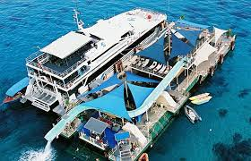
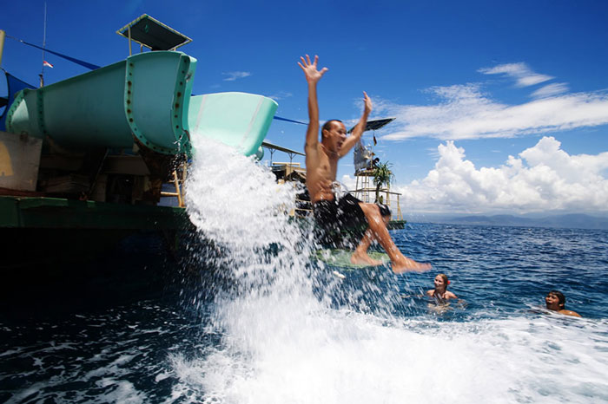
Lembongan Island Reef Cruise
Detail Itinerary
The Bali Hai Cruise to Nusa Lembongan Island offers a full day of fun activities for your family. Our luxury catamaran departs Benoa harbor at 9.15am each day to cruise from Bali to Nusa Lembonganwhere it moors alongside our purpose-built pontoon, which is packed with activities for the whole family.During this day trip, you can see Lembongan island’s exotic marine life and colorful corals from the comfort of our semi-submersible coral viewer, by going snorkeling in beautiful Lembongan Bay, or even by trying scuba diving for the first time with our experienced team of PADI diving Instructors.Other cruise activities include unlimited banana boat rides, tour of Lembongan Island or our exciting 35 meter waterslide. The Bali Reef Cruise is on of the island’s top family activities.And when you’ve finally worked up an appetite, feast on a delicious buffet served in air-conditioned comfort aboard Bali Hai II.
The Bali Hai II departs from Nusa Lembongan Island around 3.15pm and slowly cruises back to mainland Bali as you relax and enjoy the view across the ocean. If you are not ready to go home then perhaps you want to join the Aristocat Evening cruise.
Journey Highlights
• Travel on the ocean by a luxury catamaran
• Experience fun activity and facilities available at pontoon
• Explore the island's exotic marine life and colourful corals
Pick Up : 07.15AM - 07.45 AM

Slide 11



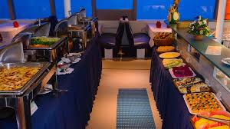
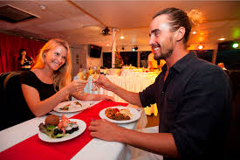
Sunset Dinner Cruise
Detail Itinerary
There’s no better way to spend a tropical evening in Bali than on Bali Hai’s Sunset Dinner Cruise.
Watch the colors of the sky change from just a hint of a colour to shades of deeper orange, purple and red while you cruise along the harbor sipping a drink on the open-air top deck of the Bali Hai II. Enjoy the sunset usually only seen on beautiful pictures. This time it is you making the magnificent photographs and memories that will last a lifetime.As the sun goes down we set off on a relaxing cruise around Benoa Harbour in South Bali aboard our luxury catarmaran, Bali Hai II. As you take in the cool night air on the top deck you will be entertained by our live musical entertainers. This is followed by a delicious international buffet dinner before you can dance the night away at our disco or enjoy our live cabaret show.Our Bali Hai Sunset Dinner Cruise is suitable for the whole family so bring the kids along to enjoy the party.
Journey Highlights
• Witness the spectacular sunset on the cruise around Benoa Harbour
• Enjoy your night with an international buffet dinner
• Variety of performances and live music will entertain you on board
Pick Up 16.15 PM – 16.45 PM

Slide 12
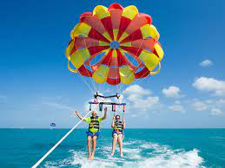
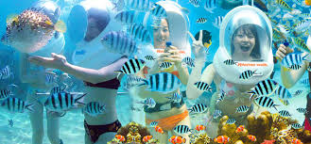
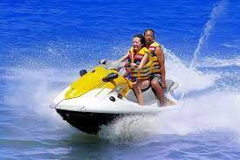
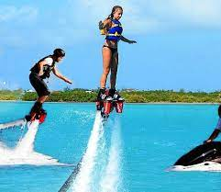
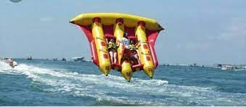
Water Sport Adventure
Located at the long white sand beaches Nusa Dua only about 40 minutes from Ngurah Rai Airport. Managed and operated with professional staff will always ready with humble service and supported by International standard of all safety equipment. You can do a complete water sports here like Parasailing Adventure, Ocean Walker (Seawalker), Fly Board, Jet Ski, Banana Boat, Donut Boat, Snorkeling and many other.
Programe Activities :
Parasailing Adventure
Fly Fish
Banana Boat
Jet Ski (with instructor)
Snorkeling
Ocean Walker
Fly Board
Note Minimum Book for 2 person

Slide 13
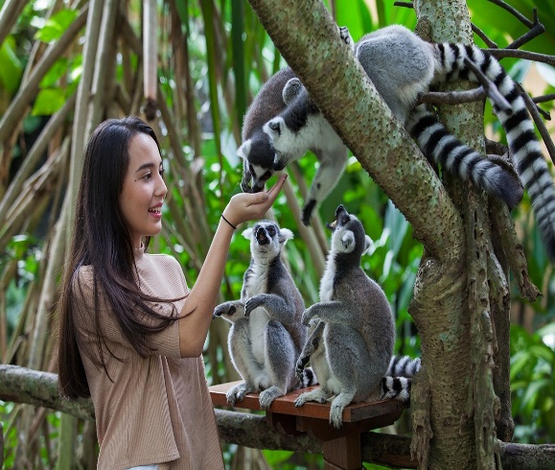
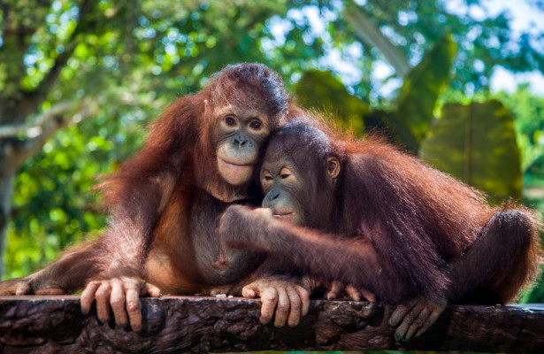
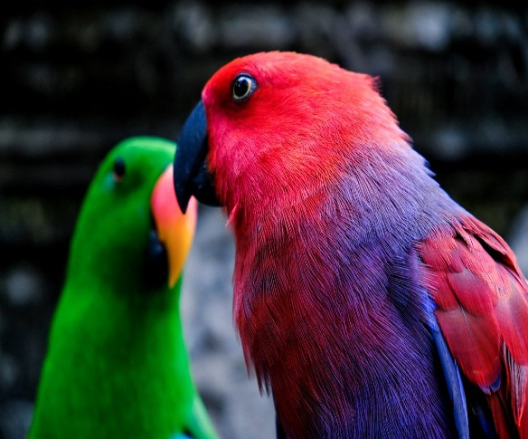
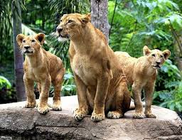
ZOO EXPLORER
"Bali's first and only zoological park is a wondrous place where you can learn the behavior of over 600 rare and exotic animals in a lush, tropical environment. A park where you can participate in fascinating animal adventure activities, some of which are unique experiences of their kind in Indonesia.“
Includes : Hotel Return Transfer, Zoo Admission, Jungle Splash, Lunch , Show , Insurance.
Pick up : 08.30-09.00, 11.30-12.00
Return : 02.00 PM, 05.00 PM
IDR 920.000 / ADULT
IDR 650.000 / CHILD

Slide 14
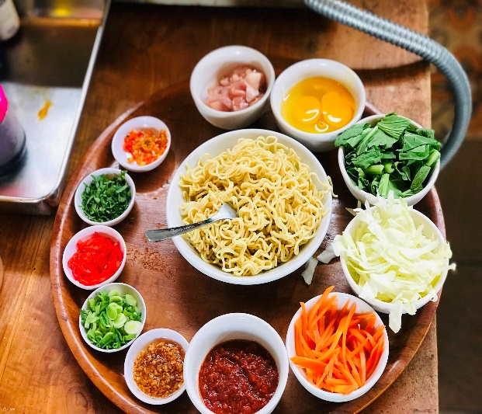

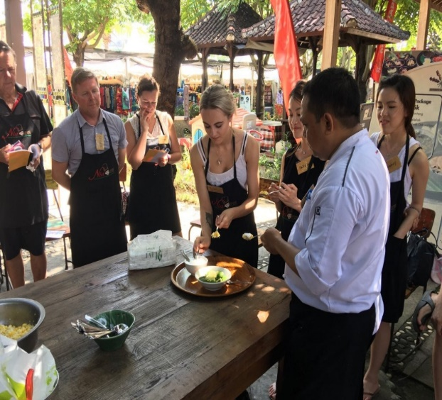
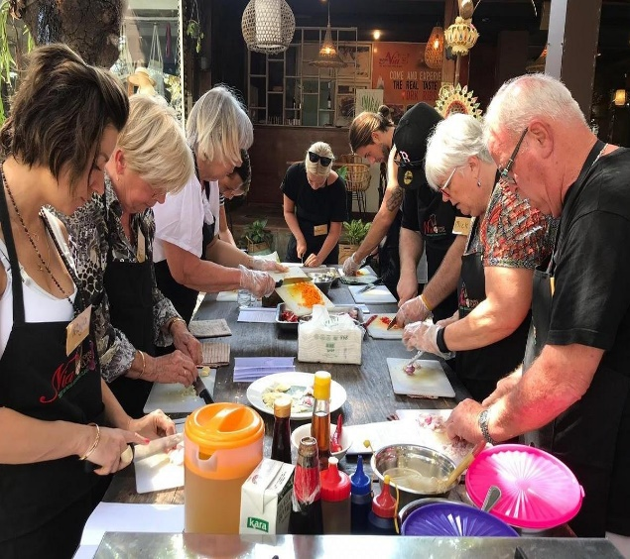
Warung Nia Cooking Class in Seminyak
Detail Itinerary
Enjoying cooking is all about confidence, being relaxed and understanding your ingredients. You will experiment with new flavours and combine the freshest ingredients with techniques, to build your knowledge of Balinese cuisine.
Visit Market
Morning Tea with Balinese cake
Class time 12 Menu
Lunch, Transport Return.
Menu Cooking : Spice Paste for Seafood (Base Be Pasih) Spice Paste for Chicken (Base be siap), Roasted Chicken in Banana Leaf ( Ayam Betutu), Chicken Satay, Peanut Sauce, Miced Seafood satay (Sate lilit ikan), Miced Chicken in banana leaf (Tum Ayam), Green Papaya salad with chicken, vegetable Salad in peanuts sauce, Sweet corn coconut snack (Urab jagung), Fried rice with chicken, Pork in sweet soy sauce ( be celemg base manis)
Schedule Every Morning , MONDAY to SATURDAY
Pick up : 07.30 Am (Starting at 08.00 for visit market)

Slide 15
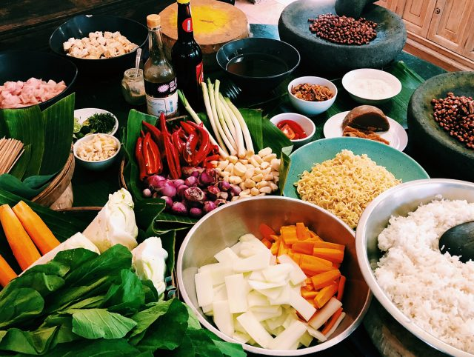
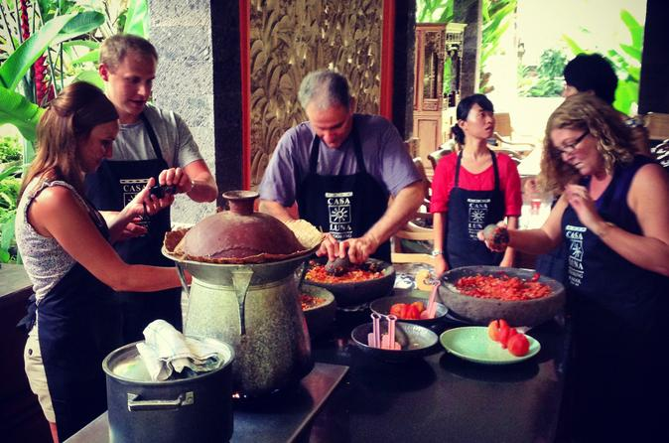

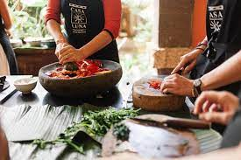
Casa Luna Cooking Class in Ubud
Every cooking class will offer a chef as your instructor, apron, and also your own cooking station with sufficient in-house cooking utensils to begin your cooking journey. In the morning, a driver will pick up students from their hotel as early as 8.00am for Monday, Wednesday and Friday classes. However, classes on those days will not include a local market tour in the itinerary.
If you wish to take up the local market tour, you can do so on Tuesday and Thursday where the pickup from your hotel can be as early as 7.00 am.
Classes will start at 8.30 am and usually ends by 1.00 pm. So you can plan for the rest of afternoon in Ubud or choose to explore the grounds of Casa Luna. Surrounded by lush forest and Balinese decorations, it makes a great place to relax and unwind at the bakery or restaurant here too.
Included :
Visit Local Market on Tuesday and Thursday
Cooking Class
Lunch
Transport return
Minimun booking 2 Pax
Pick Up : 06.30 AM

Slide 16
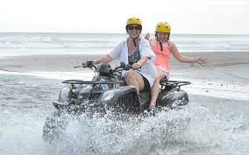
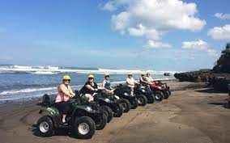
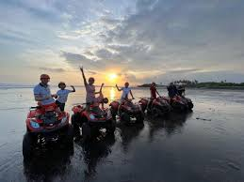

ATV ON THE BEACH TOUR
Our world famous ATV (Quad Bikes) on the beach, Bali’s one & only fully licensed and permitted ATV tour on the beach. We ride along countless miles of remote black sand beaches, then up through scenic world heritage listed rice fields, jungle tracks and down through traditional local villages then back onto the beach for a final run.
Single ride is solo on the ATV, ages 10-12 and above can ride single. Whilst a tandem ride is usually 1 adult and 1 kid under 10-12 years, 2 smaller adults can do tandem but for safety reasons, Maximum combined weight for tandem ride is 155kg.
Bring with you: Sunglasses, sunscreen, normal Bali clothing is fine, shoes are better if you have them, if not thongs are ok, change of clothes is optional, we have towels for you.
Includes: Return transfers, meal and drink, onsite insurance, all safety gear and training, bottled water, refreshments, new jungle fun area, all government taxes, and photographer options.
Pick up times: .
Morning 7.30 AM
Middle 10.30 AM
Sunset 2 PM

Slide 17

ADMISSION WATERBOM BALI DAY PASS
Waterbom Park
  First opened on the island of Bali just over 28 years ago, in 1993, Waterbom Bali is a boutique, botanical waterpark experience, nestled in the heart of Kuta. The park was built with the aim to create a space that provides visitors a memorable and fun experience, while also respecting the natural world around us. Thus, Waterbom Bali was consciously developed to complement the existing environment, with over 50% of the area’s local greenery being conserved, and all the slides and features of the park built around the existing flora and fauna, rather than over it.
  Surrounding Waterbom’s world-class slides and attractions, lies a carefully landscaped sanctuary of gardens and water systems proudly representing the beauty of Bali.
  To this day, Waterbom encompasses 3.8 hectares, including slides, our popular ‘Pleasure Pool’ with swim-up bar, private gazebo areas, expansive lawns and multiple restaurants and still maintains more than half of the park as green space, including a number of endangered native species.
Open : 09.00 AM – 18.00 PM

Slide 18

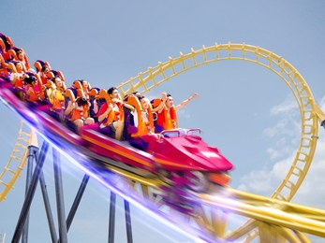


TRANS STUDIO THEME PARK
The most complete Entertainment Business Unit from CT Corpora, Trans Studio has a family recreation concept in the form of an indoor theme park which presents themed indoor game areas with world-class rides such as roller coasters with reverse maneuvers at Trans Studio Bandung or roller coasters that are on top of buildings in Trans Studio Cibubur and Trans Studio Bali. Starting in 2011, Trans Studio Bandung continued to expand with the opening of Trans Studio Cibubur and Trans Studio Bali. In addition to presenting world-class rides, visitors can also enjoy attractions in the form of spectacular shows that can be enjoyed at Trans Studio.
Package Includes
Theme Park Package ( Fly Over Indonesia, Puppet Master, The Forbiden Temple, Ninja Course, Lucky Tree Climber, All Show, Formula Kart, Frank House, Bat Gilder, Boomerang Coaster, Illusion House, City of Dead, Road Race , Were Wolf World, Kids Playground.
Pick up 11 AM

Slide 19

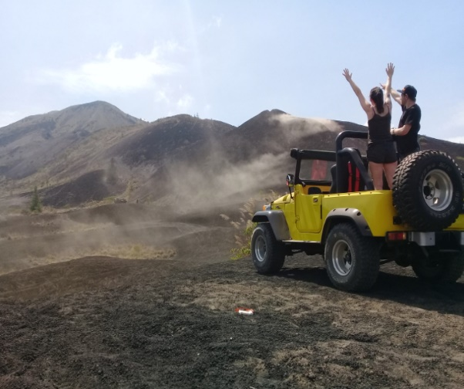
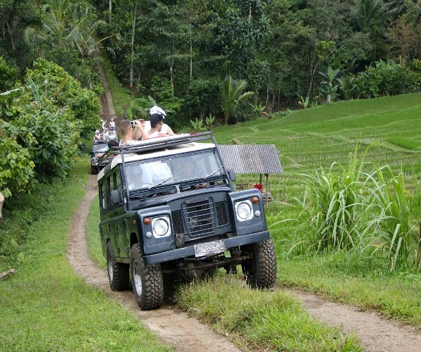
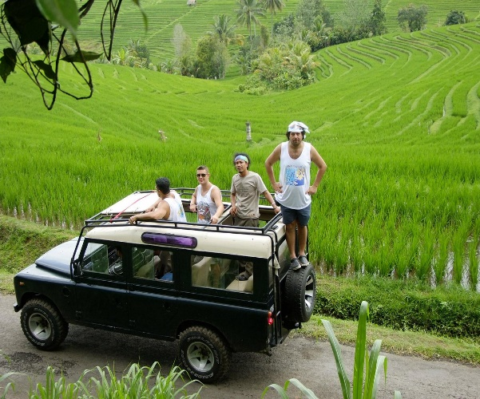
“Mystical Volcanoes” by Bali Jeep Tour
Itinerary :
First we will visit the famous Waterfall (Cepung) or (Krisik Waterfall) . After enjoying the feeling of the magic of the Waterfall then drive to Kedui Village. This time we will have the chance to astonish ourselves about the process of coconut palm wine making (Tuwak), We will then drive directly to the bamboo forest, with its mystic and natural environment, After this, we will then visit many kinds of tropical gardens such as: Arabica coffee, Japanese pumpkin, and you stop at the one of the oranges gardens we can take and try fresh orange from their tree, etc. Take amazing photos in the “pine forest” while enjoying the cool mountain breeze, before we continue to drive Off Road in Black lava with their silent history. Our lunch will be served at a local restaurant with views of the amazing Batur Geopark and lake with surrounding hillside. We will continue driving through the hill through the tropical forest of Kintamani, where marvellous views are waiting for us, like Batur Volcano and Lake, Abang Mountain and Agung Mountain, the highest sacred mountain in Bali, then visit the Temple of Bubung Renteng, a very authentic temple on the top of the Kintamani Hill,
Pick Up : 07.30 AM – 08.00 AM (Sharing Tour)
Tour Includes: ● Whole tour, using 4x4 open roof Jeeps ● Professional English speaking driver and other guide on availability. ● Coffee or tea at breakpoint ● Mineral water and soft drink on the vehicles ● Lunch with valley view ● Entrance fees ● Parking fees

Slide 20
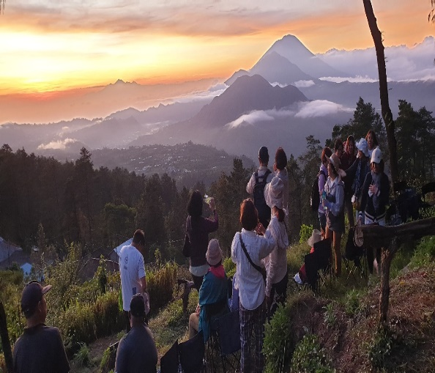
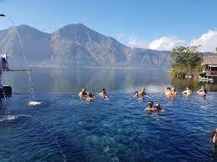
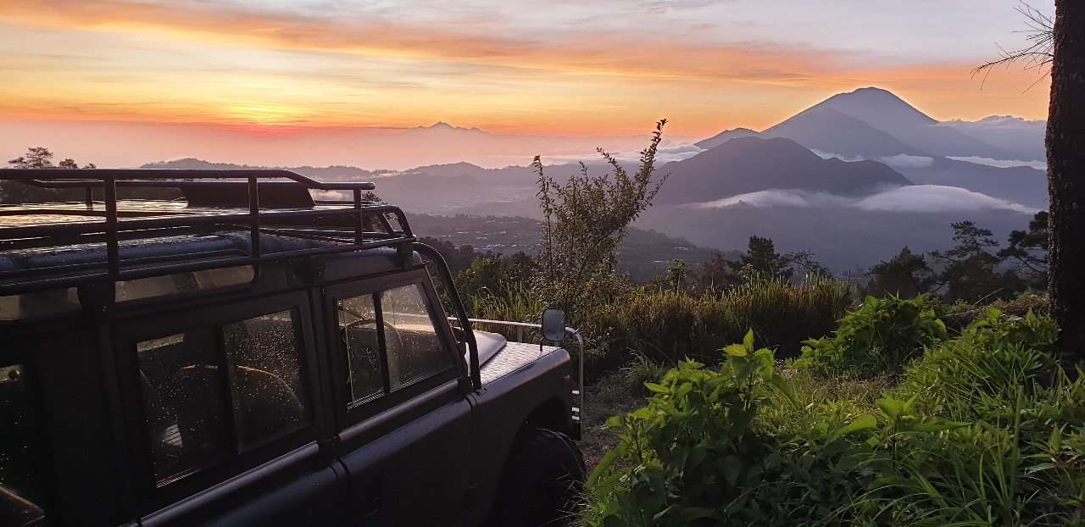
“Amazing Jeep Sunrise” by Bali Jeep Tour
Itinerary :
Sunrise and Black Lava Adventure
- 04.30 am from the area of the hotel in Ubud, we drive through point
- 05.30am arrive at the point of sunrise in Penulisan, prepare your camera or video while waiting the sunrise appearing.
- 05.50 – 05.55am usually the sunrise will appear at between 3 of volcanos as well as Batur, Abang and Agung mountains, where we enjoy take an amazing photos and videos for the memorable trip in Bali.
- 06.30 - 07.00am after the sunrise we will then drive to Sahara point to enjoy soft off road where on the volcanic black sand and get a good spot of photos while our team and driver will prepare the picnic breakfast, hot coffee or tea at the break point.
- 08.00 – 08.30 After enjoy breakfast our trip will continue to the next adventure drive through on the Black Lava of the Batur Volcano with magnificent photos point on the jeep and make many photos of groups.
- 10.00am arrive at the Hot Spring, and get relax our body after cold temperature in the morning and little pump the adrenalin drive through black lava.
- 11.30am Everyone already feels fresh after enjoy the hot spring we will then continue to last visit is the Penglipuran village to see the traditional Balinese compound and bamboo forest in the area.
- Before arrive at the village, we will then take stop at local restaurant to having lunch while enjoy the panoramic of Mountain and Lake Batur.
- From the restaurant take around 30-45minute drive down to the village mention Penglipuran is the one very famous for the tourist point, our guide will explain the village history and fell their own tradition it is experience Bali as well.
- After finish visiting the village of Penglipuran, the next trip is back to your hotel and the Adventure is done.
- 14.00-15.00h will arrive at the hotel in Ubud.
Pick Up : 04.00 AM (Sharing Tour)
Tour Includes: ● Whole tour, using 4x4 open roof Jeeps ● Professional English speaking driver and other guide on availability. ● Coffee or tea at breakpoint ● Mineral water and soft drink on the vehicles ● Lunch with valley view ● Entrance fees ● Parking fees

Slide 21
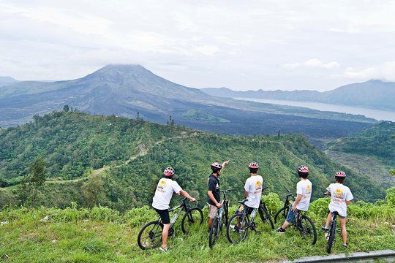
Mountain Cycling By Mason Adventure
Get ready to embark on a journey off the beaten track, through some of Bali’s most scenic highland locales. Start your ride near the renowned Mount Batur Volcano, overlooking Kintamani Lake, and cycle down through 30kms of forest trails, ancient Hindu temples, villages, rice fields, and plantations, sampling exotic fruits at their natural source.
TOUR INCLUSIONS
Modern Mountain Bikes & Helmets
Lunch
Mineral Water During Trip
Refreshing Cold Towels
Air-Conditioned Hotel Transfers
Adult : 13 yrs – 65 yrs, Child 10 yrs – 12 yr
Pick Up : 07.30 AM – 08.00 AM

Slide 22
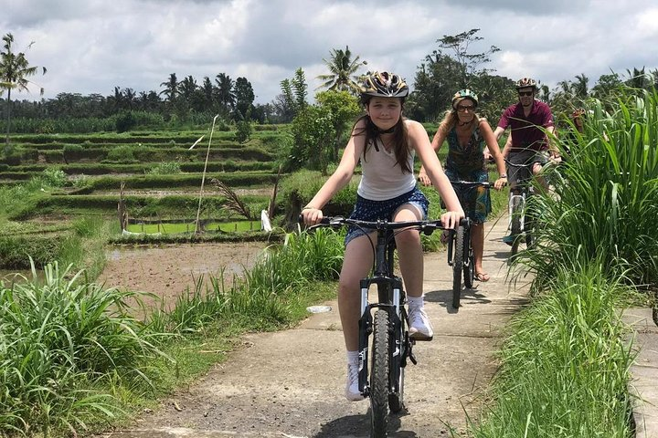
Kintamani to Ubud Downhill Cycling Tour
Off The Beaten Track Down Hill Bali Countryside Cycling Tours. Enjoy the quiet countryside of Bali’s back roads and witness first-hand the daily life of rural rice farmers and craftsmen.
Includes
Morning pick up from Bali Bike Baik Cycling Tours at your hotel and A/C ride up the country based on sharing.
A Walk into the rice paddies to learn how rice is grown and cultivated.
A look at Balinese coffee plantations and some of the more unusual plants of Bali, as well as a visit to a village temple with an introduction to Balinese spiritual beliefs.
A magnificent luncheon in the family compound of tour guide Wayan ‘Bike – Baik’. This personal welcome to his traditional family life has proved to be one of the most popular components of the tour.
Wayan’s genuine warmth and enthusiasm for sharing his culture will guide you through everything from the how’s and why’s of daily offerings, to the amazing relationship between Balinese architecture and it’s spiritual practices.
insurance
Pick Up : 07.00 AM – 07.15 AM

Slide 23
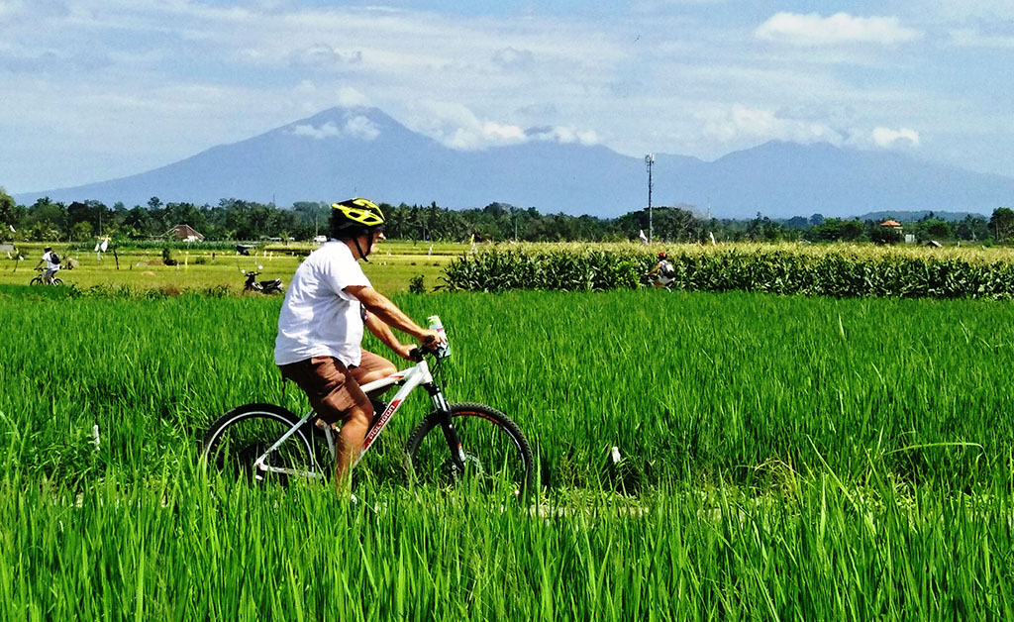
Green Bikes (E Bike) Jatiluwih Surroundings
Inclusion in our bicycle tours:
This 2 hour cycling trip with our electric bikes starts from the Batukaru temple (no temple visit) and takes you past beautiful landscapes to Jatiluwih where you cycle through its stunning center, guided by one of our experienced local cycling guides who happily shares his/her knowledge about this UNESCO World Heritage site. The road from Batukaru to Jatiluwih has some beautiful scenery but is very different from the central Jatiluwih area. We pass with the easy to use e-Bikes by dense jungle, giant bamboo forest, local villages, rice terraces, plantation and vast valleys. Jatiluwih consists of more than 300 hectares of stunning nature, rice terraces and lush tropical vegetation.
Following your cycling trip a tasty authentic Indonesian meal is served in Green café, located in the center of Jatiluwih and surrounded by rice fields. All ingredients are locally and organically grown. After enjoying your tasty meal and relaxing a bit in these beautiful surroundings the driver brings you back to your hotel or villa.
Highlights
Explore rarely visited parts of the UNESCO listed Jatiluwih by e-bike
See stunning nature and learn about traditional Balinese life
Pass by dense jungle, giant bamboo forest and local villages
Enjoy an authentic Balinese lunch surrounded by rice fields
Pick up 07.00 – 07.30 AM (Min 2 pax)

Slide 24
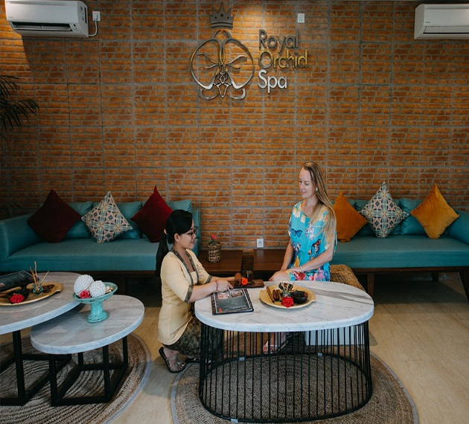
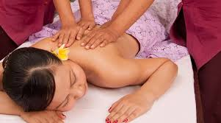


Massage &SPA Package
Balinese believe that body, mind and spirit work in harmony. Health and well being leads to happiness. Our massages have healing power, releasing tension, freeing tissues of toxins and improving circulation.
Reflexology Foot Massage at our SPA relieves stress from areas in the feet that are in harmony with other areas of the body and increases the rejuvenating and revitalizing powers of the whole being. Herbal, lemon, and ginger teas are natural medicines. They relax or stimulate, soothe and energize, rejuvenate and revitalize. At Bali Orchid SPA we offer the true Balinese hospitality and focus on the well being of our guests in a beautiful garden setting. Visit us and experience the joy of Balinese Holistic Care.
SPA PACKAGE :
1. Balinese Massage (1 Hrs)
2. Manicure/Pedicure (1 Hrs)
3. Lulur Package (2 Hrs)
4. Refreshing Package (2 Hrs)
5. Relaxing Package (3Hrs)
6. Honeymoon Package (3 Hrs)

Slide 25




Fast Boat Transfer to Gili, Ns Penida or Lembongan
Fast Boat Transfer (include share transport pick up) Minimum for 2 Pax
1. Gili Island : Transfer with Bluewater express fast boat.
2. Nusa Penida Island : Transfer with Maruti fast boat.
3. Lembongan Island : Transfer with Glory fast boat.

Slide 26


DEVDAN SHOW
Bali Nusa Dua Theatre is the premiere setting to showcase Bali and Nusantara’s rich and diverse cultures with stunning illusion, dazzling costumes, uniquely artistic contemporary cultural dances and heart-stopping aerial acrobatic performances. The audience is taken on a magical journey across Bali and beyond to the Archipelago of Indonesia. This 45-minutes mega production of devdan is a “must-see” show where you discover Indonesia in a thrilling and enchanting way, as never experienced before. See the show and be prepared to fall in love with our amazing Indonesia.
Pick up : 18.00

Slide 27



Canyon Tubing
Make your way through a secluded canyon by land, water, and air in one exciting trip! Drift down the Siap River in your own inflatable tube through the virgin wilderness on an idyllic stream hidden inside a secret canyon. First, climb aboard one of our 4WD vehicles (navigated by our guide) for a fun-filled ride through the jungle to the canyon, and then jump into your tube. The river current (no paddling necessary) will float you down while our guides will give you commentary on the area. If you’re lucky, you might spot monkeys or rare birds nestled in the treetops. At the end of the tour, our off-road vehicle will bring you from the riverbank to our base camp (no torturous stair climbing before or after the tour!).
Pick up 07.00 – 07.30 AM (Min 2 pax)

